Slide 1
Engineering your GenAI Assistant
Best practices, ethics and safety guardrails for engineers

Slide 2
What is GenAI anyway?
It’s a probability engine not a dictionary
Generative Large Language Models (LLMs) do not "think," nor do they search database indexes like traditional search engines.
Instead, they analyse vast pattern structures from training corpuses to predict the most likely next word (or "token") in a sequence based on your input.
Notes:
Get participants to help you answers this, get their takes on what AI is

Slide 3
Data Privacy and Protection
When using consumer models (like free ChatGPT), any proprietary code, coursework, or data you input can be scraped, stored, and utilized to train future iterations of the model.
However, when using your Copilot subscription provided by the University, your prompts are not stored or used to train future models.
Notes:
Talk about data training and how this is prevalent in consumer models but how copilot etc is safe.

Slide 4
“Never use it tired”
The Overconfident Junior Engineer
Picture an indefatigably energetic junior engineer who draws up structural plans without doubt, whether his figures are superb or made up entirely.
If you are too exhausted to notice a flaw in either your programming or mathematical reasoning, you do not want to rely on GenAI to do your work for you.
Notes:
Focus in on this concept and get people to think of times they’ve used it and not verified it

Slide 5
Academic Responsibility and Conduct
Never claim something is yours if it isn’t
Use it wisely
Task | Permitted | Prohibited
Coding | Debugging syntax and errors | Copying full scripts from AI
Lab report summaries | Formatting data structure, refining grammar | Let AI synthesize conclusions/analyses of data
Literature Reviews | Finding relevant key works and summarizing broad fields | Generating or using fabricated citations
Mathematical derivations | Explaining theorem rules | Having AI solve graded homework sheets
Notes:
Explain uni regs as well as moral conduct

Slide 6
Research formulation strategies
Chain of Thought
Instruct the AI to show its working steps. Prompt: "Break down the stress-tensor calculation step-by-step before calculating the final value." This dramatically reduces mathematical hallucinations.
Demand Citations
Prevent false references by prompting: "Only use verified, real-world URLs and standard journals. State if you cannot find a primary source." Always manually verify every DOI provided.
Iterative Critique
Ask GenAI to actively spot weaknesses in your drafts: "I will provide a code draft. Act as a systems debugger and find potential edge-case failures or memory leaks in my logic."
Notes:
Explain these don’t make AI better they just give the user a leg up on how to use it well

Slide 7
Prompting: Context and Structure
Assign an Explicit Role
Do not ask: "Explain concrete stress limits."
Define Constraints and Format
Explicitly limit the scope of the output to eliminate fluff.
Prompt: "Act as an academic peer reviewer in structural engineering. Review this abstract for logical fallacies." Setting the role aligns the predictive vector space to high-level technical parameters.
Prompt: "Explain the thermodynamic constraints of this cycle. Keep explanations under 200 words. Format key findings in a bulleted list and use Markdown for equations."
Notes:
Reiterate that prompting doesn’t make AI better but allows the user to make the most of it

Slide 8
Algorithmic Bias & Data Gaps
The biases in the data used to train an AI system will be reproduced by it.
An excess focus on datasets from the Global North may neglect the engineering principles specific to other geographic locales.
Technical knowledge such as legacy code or unique building materials becomes "background noise."
Engineering innovations that seem statistically unlikely are overlooked.
Notes:
Explain how the training works and how novel solutions will never come up as this is filtered off as noise, ask people for examples

Slide 9
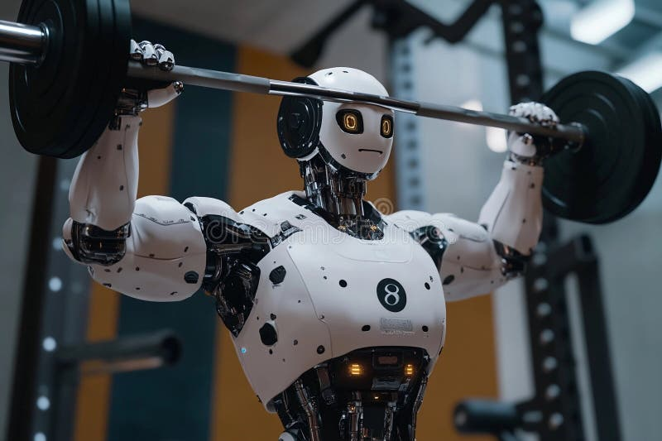
The Human Judgement Line
Some decisions just can’t be done with AI
Notes:
Imagine your lecturers as PTs, they can tell you what to do and by doing it you gain knowledge
By getting a robot to lift those weights, no one wins

Slide 10
What to balance
Cost
Risk
Time
Ethics
Judgement

Slide 11
An AI ethical framework
Principle I - Verification
Principle II - Traceability
Principle III - Ultimate Liability
Principle IV - Boundary clarity
Principle V - Stewardship

Slide 12
Sustainability flop of AI
Emissions
Grid dependency and power requirements
The cooling strain on bodies of water
The sound and biodiversity impact of datacentres
Notes:
Talk through misconceptions about AI, get people to give anecdotes and allow time for questions

Slide 13


